Slide 1
Csci465: Principals of Translations Chapter 8: Code Generation
UND School of Electrical Engineering and Computer Science
Department of Computer Science
Dr. Hassan Reza

Slide 2
Objectives
Issues in the design of code generations
Approaches to code generations
syntax-directed translation/definition technique to generate code
Stack machine

Slide 4
Input to code generators (CG)
Input to the code generator are
Three-address code (3AC)
Quadruples
Triples
Indirect triples
Virtual machine (bytecode, stack-machine code)
Linear representations such as postfix
Graphical representation (syntax tree, DAG)
…

Slide 5
Output of CG: Target Code
The most common target-machine architectures are
RICS (reduced instruction sat computer)
Uses many registers, 3-address instructions, simple addressing modes, simple instruction-set
E.g., MIPS
CISC (complex instruction set computer)
Uses few registers, 2-address instructions, many addressing modes, several register classes, variable-length instructions, etc.
IBM-370 Series
Stack-Based Architecture
Uses push/pop operations and operands pushed on stack

Slide 6
Approach to Code Generations
Two possible approaches
Formal Methods and Compiler (e.g., using Theorem prover)
Syntax-Directed Code Generation (SDCG)

Slide 7
Formal Method driven
Theorem Prover approach
Describes the object code using Attribute Grammar
Use a Theorem- prover program to produce the correct translator to map the source program into object code
Not very successful!

Slide 8
Main Tasks of CG

Slide 9
Instruction Selection

Slide 10
Register Selection

Slide 11
Evaluation Order

Slide 12
Simple Machine Instructions

Slide 13
Simple Target Machine: Addressing Modes

Slide 14
Execution Cost

Slide 15
Some examples of machine codes

Slide 16
Generating code for handling the stack

Slide 17
More on stack

Slide 18
Basic Block and Graph of 3-AC

Slide 19
Basic Block

Slide 22
Graph

Slide 23
Syntax Directed Code Generation
Chapter 8

Slide 24
Syntax-Directed Code Generation
The main goal of compiler is to translate the source program into the object code
Object code must have the same semantics as the source program
i.e., compute the same results with different syntax

Slide 25
Code Generation: Preview
Code Generator
The process of mapping some intermediate representation (IR) of the source program into assembly
Acts as a match maker between source and target language constructs
Source is a new language
Target is very well established (low-level) language

Slide 26
Important issues in designing the code generation (CG)
Design of the CG may depend upon many details such as
Intermediate code representations
Target language
Run-time system
Instruction selection
Register allocations and assignment
etc.
But the most important criterion for a code generator is that it MUST generate correct code

Slide 27
Approach to CG: Syntax-Directed Code generation
Syntax-directed code generation
The code generation sequences are embedded in the grammar that specifies the syntax of the source
Parser decides which set of instructions to be emitted based on the syntax of the source code
Parser maps source syntax to code sequences

Slide 28
Using Stack Machine and SDD
Stack machines
have been around since the 1960s (e.g., Burroughs B5000 and their successors)
have an elegant architecture offering a lot to computer science,
Unfortunately, stack machine is viewed as outdated and slow

Slide 29
Stack: Organization
In stack machines, the arithmetic logic unit(ALU) and memory management unit operate at the top of the stack:
all ALU operands and memory writes are popped from the top of the stack and
all ALU results and memory loads are pushed to the top of the stack.
Called implicit-addressing machines since no explicit reference to operands are required.

Slide 30
Advantages of Stack
stack machines do have number of advantages:
low power requirements;
small size and cost;
fast, highly predictable interrupt performance.
work best with small program sizes, reducing memory cost and band-width requirements
A good choice for RT-Embedded Systems!!

Slide 31
Hypothetical Machine: ITTY BITTY Stack Machine (IBSM)
Engineering the compiler demands a complete understanding of the target computer machine
Some computers have a very complex instructions sets
CICS (Complex Instruction Set Computer)
Tutorial on any specific machine is very time-consuming
Using Hypothetical Stack based machine, “the Itty Bitty Stack Machine” or IBSM

Slide 32
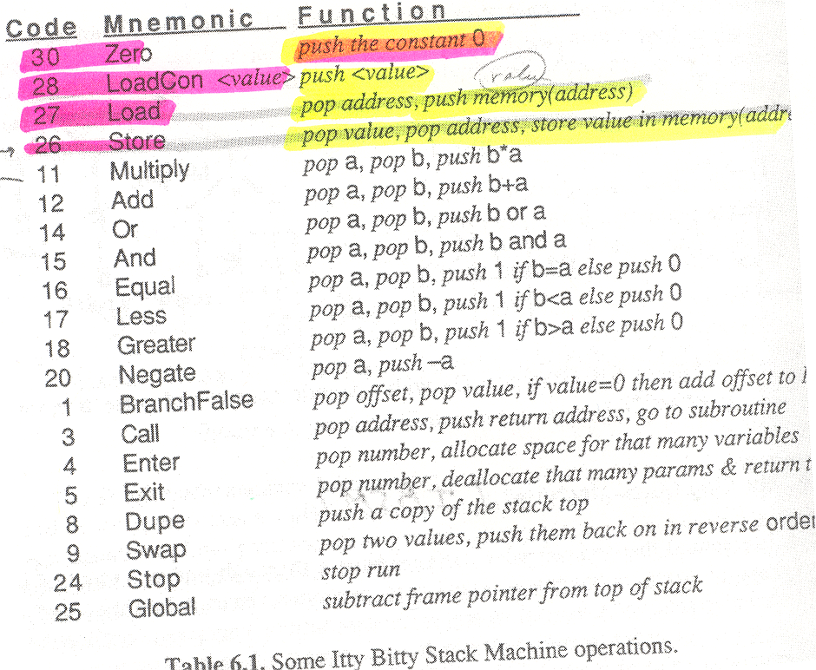

Slide 33
Stack Machine Expression Evaluation
Stacks used for Parsing (PDA)
Stack simplifies expression evaluation
No need to save and/or compute intermediate results
E.g., 3*4+5*2 (i.e., 3,4,*,5,2,*,+)
2
4
5
5
10
3
3
12
12
12
12
22
Load 3 Load 4 Multiply Load 5 Load 2 Multiply Add

Slide 34
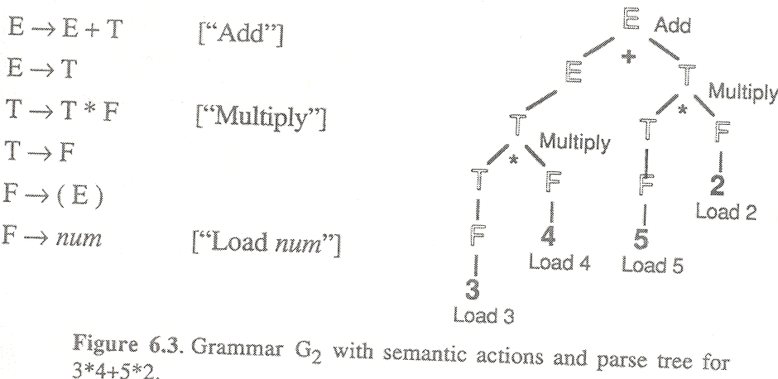
Left-to-right post-order tree walk for 3*4+5*2 (i.e., 3,4,*,5,2,*,+)

Slide 35
Instruction Stack
Load 3 3
Load 4 4, 3
Multiply 12
Load 5 5, 12
Load 2 2, 5, 12
Multiply 10, 12
Add 22
Execute 3*4 + 5*2

Slide 36
Simple Code Generator
Op destination, source
Example: 7 + (8 * y) / 2
Load R1, y
Mult R1, 8
Div R1, 2
Add R1, 7
Notes:
First Operand = Destination
Second operand = Source

Slide 37
Stacks evaluation
Why Stack?
Simplicity
direct mapping to post-order tree walking and context-free parse

Slide 38
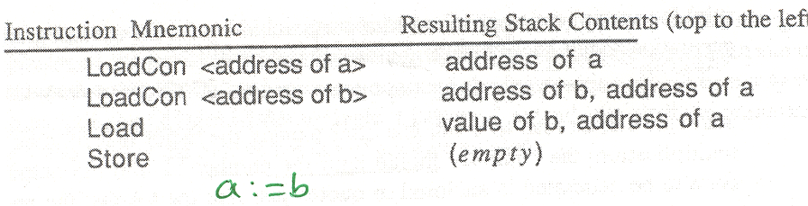
Execute: a:=b

Slide 39
Example a:= b
Using the grammar, a:= b will generate the following code:
1
2
3
4

Slide 40
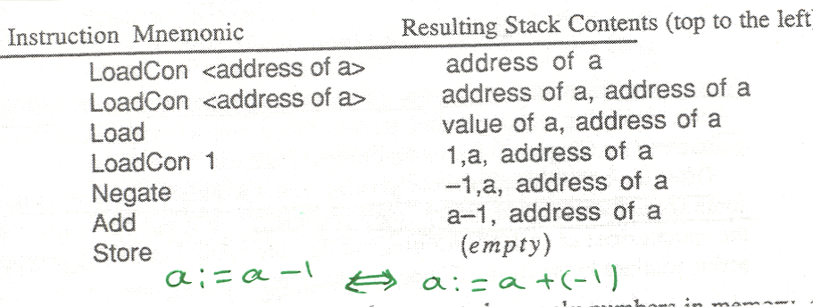
Execute: a:=a-1 ⇔ a:=a + (-1)

Slide 41
Summary of Translation process
Compilation of a program consists of:
High Level source program translated into assembly language (compiler time)
Assembly language translated into machine code for the target machine using assembler (compile time)
Linking objects program (link time)
Linked program is loaded into MM (load time)
Execute the program (run time)

Slide 42
Translation process
HL Program
Preprocessor
HL Program
Compiler
Target Assembly Program
Assembler
Relocatable Object Code
Linker
Libraries and
Other Object Files
Machine Code

Slide 43
About Assembler: 80X86 Quick Review

Slide 44
Example: Read and Write in C and Assembler Intelx86
C version:
c = getchar() ;
putchar( c ) ;
8086 version:
mov ah, 1h ; keyboard input subprogram
int 21h ; read character into al
mov dl, al ; copy character to dl
mov ah, 2h ; character output subprogram
int 21h ; display character in dl
Notes:
IntelX80 instruction has two operands: the first is the destination and the second specifies the source.

Slide 45
Complete Program
prog2.asm: read a character and display it
.model small
.stack 100h
.code
start:
mov ah, 1h ; keyboard input subprogram
int 21h ; read character into al
mov dl, al
mov ah, 2h ; display subprogram
int 21h ; display character in dl
mov ax, 4c00h ; return to ms-dos
int 21h
end start

Slide 46
More on Function/Procedure
Translated into a segmented of assembly language consists of
Boilerplate
Entry sequence instructions (prologue)
Body
Exit sequence instructions (epilogue)
Assembly codes to initialize data and announce the end of a function

Slide 47
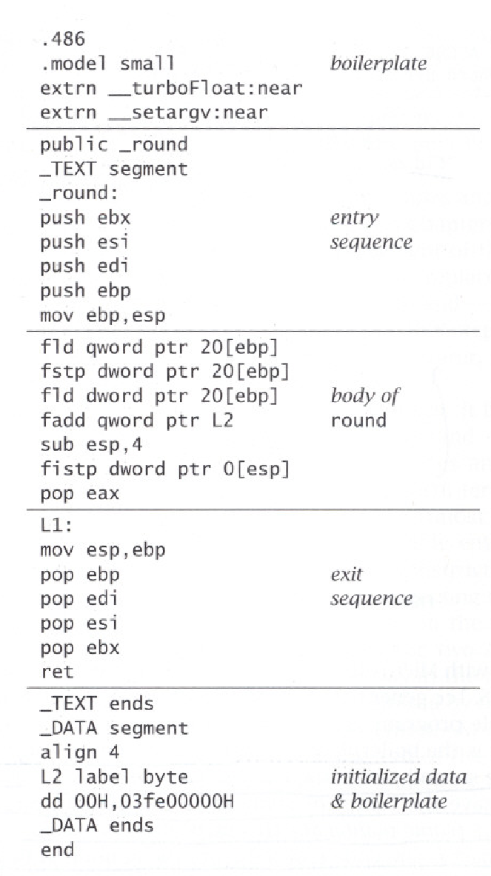
Generated Assembler Language
Or Prologue
base ptr points to the top of the stack
the top of the stack (sp) resets to points to old sp
Or Epilogue

Slide 48
The Prologue
The Prologue contains
Pseudo-instructions to declare the beginning of a function
A label definitions for the function name
An instruction to set the SP (to allocate a new frame)
Instructions to save “escaping” arguments into the frame, and to move non-escaping arguments into fresh temporary registers
Store instructions to save any callee-saved registers including the return address register ,which has been used within the function

Slide 49
The Epilogue
The epilogue comes after the body contains
an instruction to move the return value (i.e., result of function call) to the designated register
restore the callee-save registers
reset the SP (deallocate the frame)
Move Return, BODY (i.e., puts the result of body in the return)
A return instruction (i.e., JUMP to the return address)
pseudo-instructions, as needed, to declare the end of a function

Slide 50
Phase | Output | Sample
Programmer (source code producer) | Source string | Position = initial + rate * 60
Scanner (performs lexical analysis) | Token string | <id,1> <=> <id, 2> <+> <id, 3> <*> <60> And symbol table with names
Parser (performs syntax analysis based on the grammar of the programming language) | Parse tree or abstract syntax tree
Semantic analyzer (type checking, etc) | Annotated parse tree or abstract syntax tree
Intermediate code generator | Three-address code, quads, etc.
Optimizer | Three-address code, quads, etc.
Code generator | Assembly code

